Slide 1




生物系统工程分析
Microbial Inactivation for nonisothermal conditions
——Final report by group 3
课程展示
组员：黄怡婷 崔蕊艳 郑元浩
2023. 06. 15

Slide 2

1. Introduction
2. Forward process
3. Inverse process and analysis
4. OptExp Design and Bootstrap
CON-
TENTS
5. Summary

Slide 3
1
Introduction

Slide 4

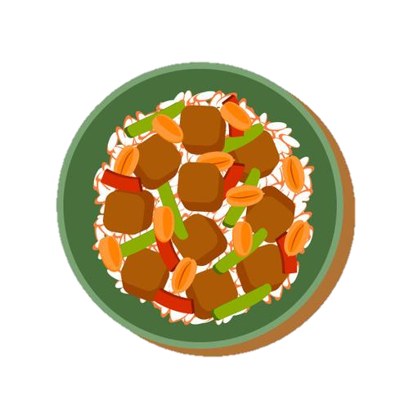

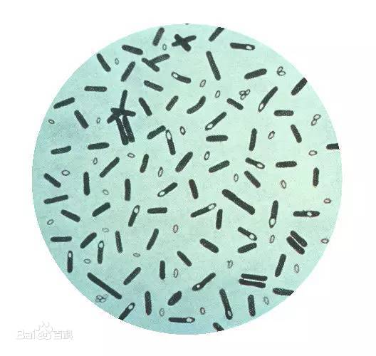
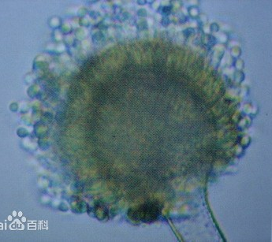
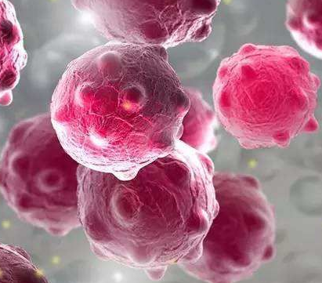
1.1 Background
Clostridium botulinum
Aspergillus flavus
Norwalk Viruses
Heat treatment
Kill or reduce the number of harmful microorganisms present in food
Notes:
Microorganisms such as bacteria, viruses, and fungi are responsible for foodborne illnesses, which can be severe or even fatal.
Heat treatment is a crucial process in the food industry to ensure microbiological safety and extend the shelf life of food products.

Slide 5
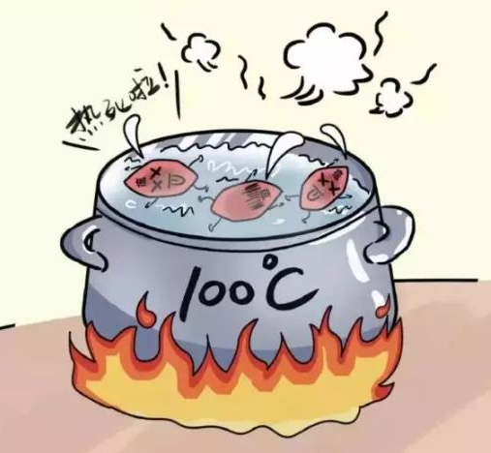
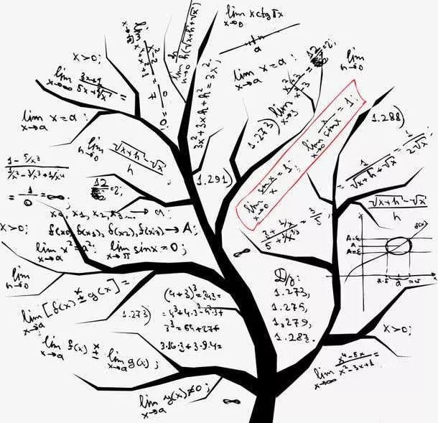
1.1 Background
Inactivation refers to the reduction or elimination of microbial organisms during a thermal treatment process.
Earlier studies mainly focused on traditional thermal processing techniques, such as pasteurization and sterilization.
Predictive microbiology uses mathematical models to predict the growth and survival of microorganisms under different conditions, allowing for more precise design of thermal processes that avoid fail-dangerous or overly conservative heat processes.
Notes:
Earlier studies xxx. These studies typically used classical microbiological methods to describe microbial growth and survival.

Slide 6
1.2 Materials and methods
1.2.1 Experiment data
Previously published data (Valdramidis et al., 2006) were used.
Liquid samples of 100 μL with initial Escherichia coli K12 microbial concentration ∼10⁹ cfu/mL were heated at three different rates (fast: 1.64, intermediate: 0.43, or slow: 0.15 °C/min)
1.2.2 Models
The Geeraerd et al. models were used.

Slide 7
2
Forward problem

Slide 8
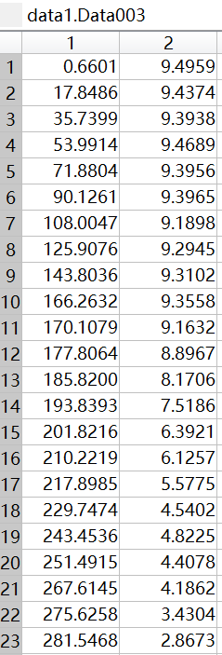
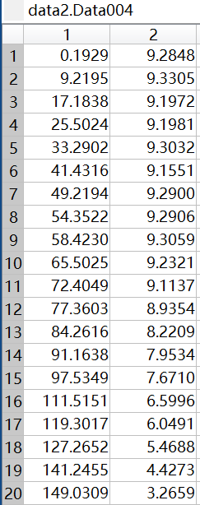
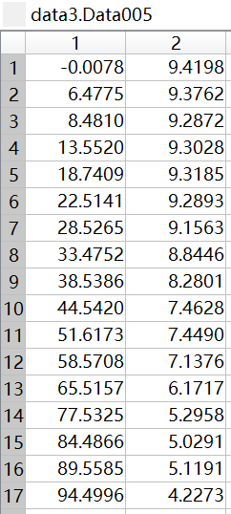
Heating rates:
0.15 °C/min
0.4 °C/min
1.64 °C/min
Notes:
First, use grabit to extract data on time and microbial load from the literature at three heating rates

Slide 9
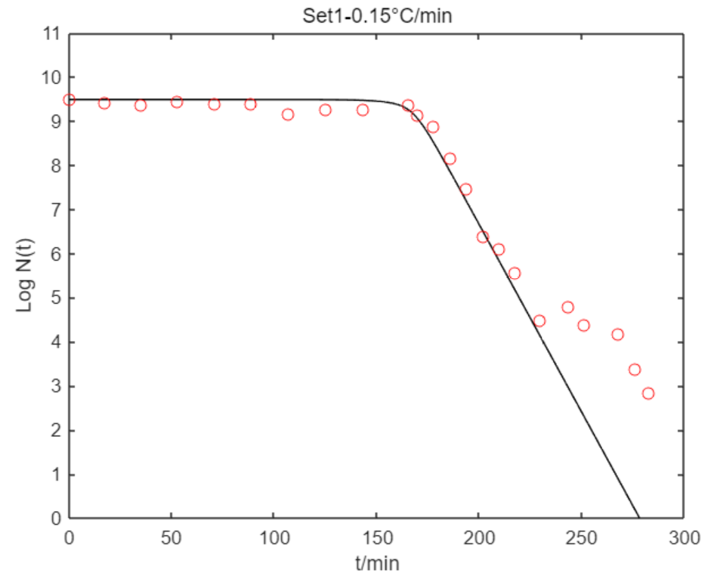
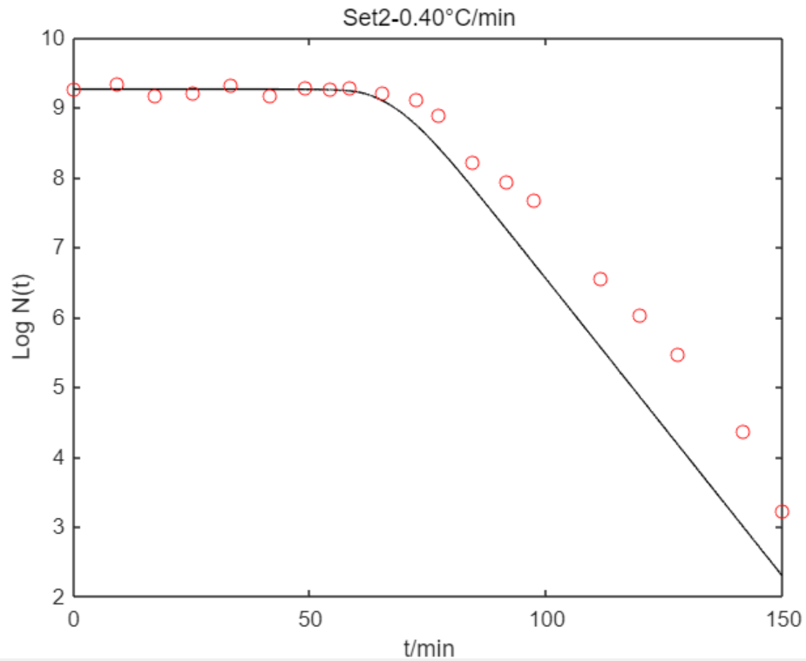
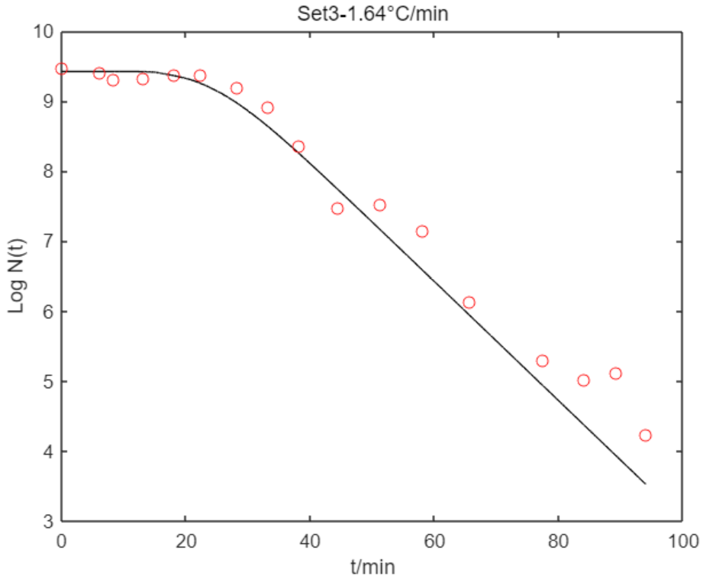
2.1 Make reasonable guesses of the parameters
Plotting the initial predicted response values (`ypredInit`) for `data set 1/2/3` against the corresponding time values (`xs`) on a plot with red dots representing the observed data (`yobs2`).
Notes:
Then, Use known parameters to predict Y. Plot Y and the data to ensure that the parameters are reasonably close to the real ones.

Slide 10
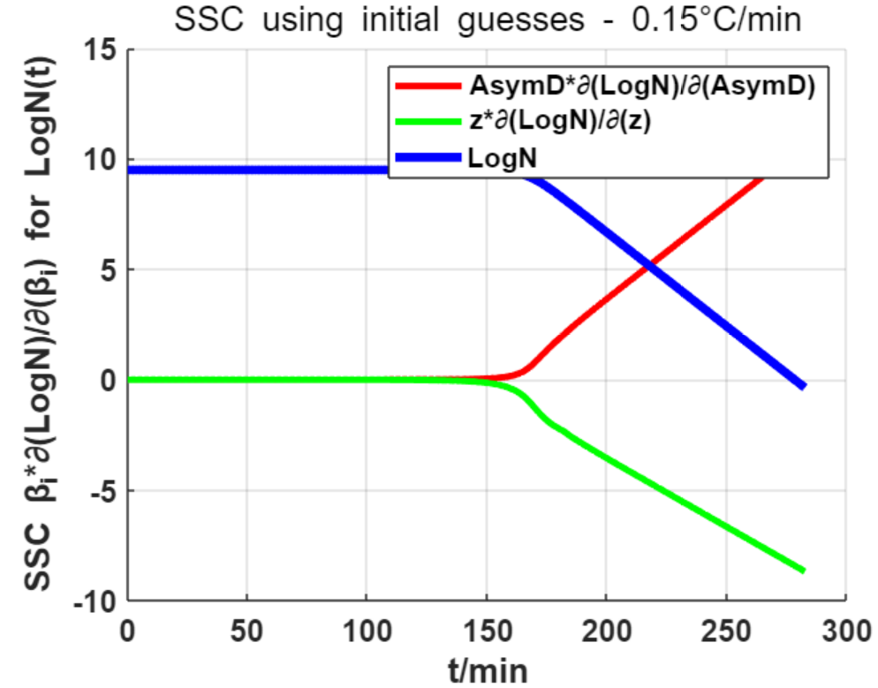
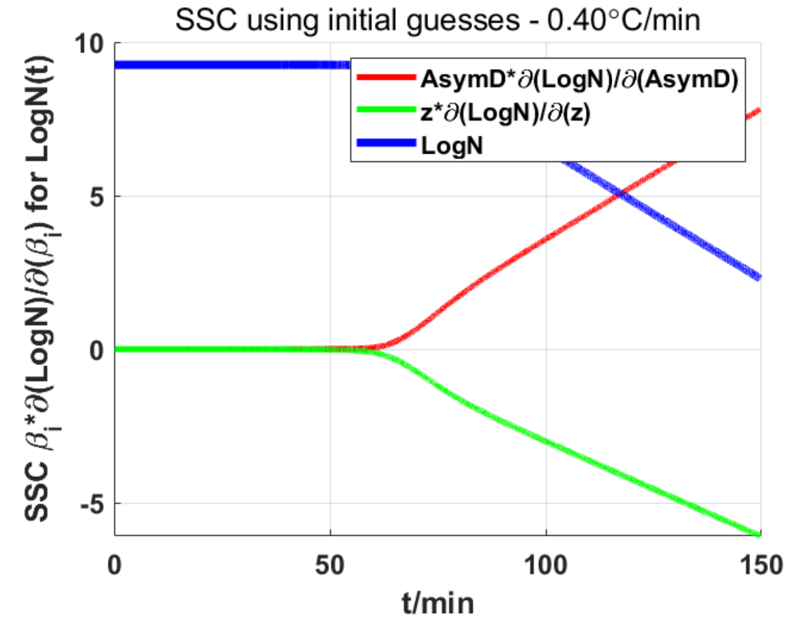
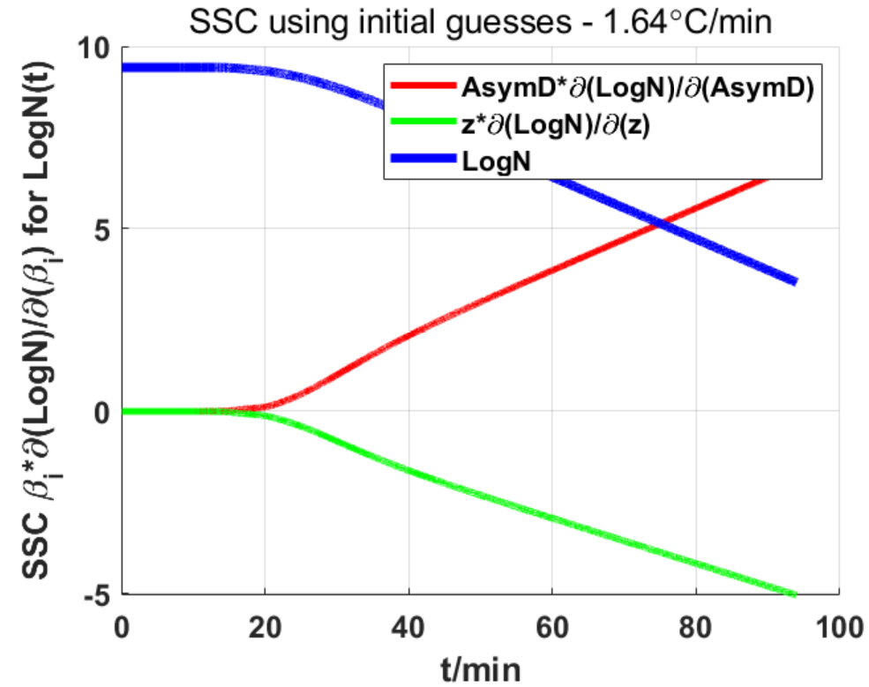
2.2 Plot the SSC for each parameter and Y predicted on the same plot.
Notes:
These are the sensitivity coefficients for each parameter , the parameters can be estimated are beta0(1) and beta0(2), and each of the two parameters could be separately estimated.
By observing the size of the SSC, beta1 is easier to estimate than beta2.

Slide 11
3
Inverse Problem and analysis
Notes:
hello, everyone! I am Cui Ruiyan. Then I will show our inverse process.

Slide 12
3.1 Parameters estimision
Estimate parameters using inverse problem with nlinfit
parameters setting
parameters estimision
logCc0 | 0.82
Tref | 56.3
Tdiff | 25
T0 | 30
B | 5*10^-4
 | Parameters | Result | Stderr | Relerr(%) | 95% Ci |  | RMSE
1 | AsymD | 6.3519 | 1.9537 | 0.3076 | 3.0521 | 10.3990 | 0.4274
2 | z | 3.5544 | 1.2000 | 0.3379 | 1.3986 | 6.2223
AsymD < z
correlation matrix
Hating rate (°C/min) | Y0 | Tcrit
0.15 | 9.49 | 168.27
0.40 | 9.26 | 61.98
1.64 | 9.42 | 15.27
AsymD
z
AsymD
1.0000
0.9984
condX = 33.8878
z
0.9984
1.0000

Slide 13
3.2 The scaled sensitivity coefficients
Heating rate = 0.15 °C/min
Heating rate = 0.40 °C/min
Heating rate = 1.64 °C/min
AsymD and z are sufficiently large for estimation.
But they are correlated.

Slide 14
3.3 Ypred/yobs with CBs, PBs
Heating rate = 0.15 °C/min
Heating rate = 0.40 °C/min
Heating rate = 1.64 °C/min

Slide 15
3.4 Residuals scatter plot and histogram
Heating rate = 0.15 °C/min
1. additive errors = 0
2. zero mean measurement = 1
3. constant variance = 0
4. uncorrelated errors = 0
5. normal distribution of errors = 1
6. covariance matrix of the errors is completely known = 1
7. errorless independent variables = 1
8. constant parameter vector = 1

Slide 16
3.4 Residuals scatter plot and histogram
Heating rate = 0.40 °C/min
1. additive errors = 0
2. zero mean measurement = 1
3. constant variance = 0
4. uncorrelated errors = 0
5. normal distribution of errors = 1
6. covariance matrix of the errors is completely known = 1
7. errorless independent variables = 1
8. constant parameter vector = 1

Slide 17
3.4 Residuals scatter plot and histogram
Heating rate =1.64 °C/min
1. additive errors = 0
2. zero mean measurement = 1
3. constant variance = 0
4. uncorrelated errors = 0
5. normal distribution of errors = 1
6. covariance matrix of the errors is completely known = 1
7. errorless independent variables = 1
8. constant parameter vector = 1

Slide 18
4
OptExp Design and Bootstrap

Slide 19
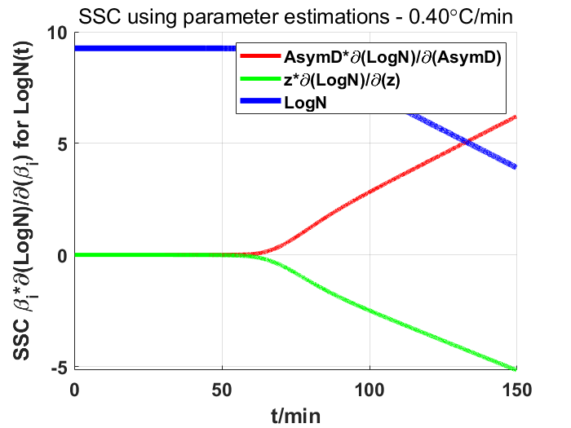
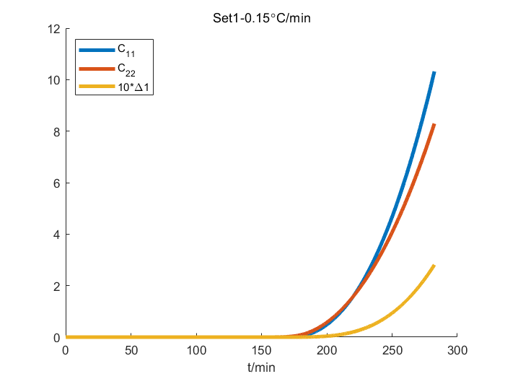
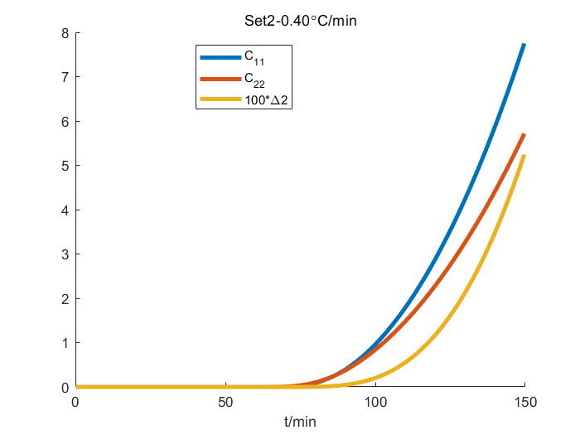
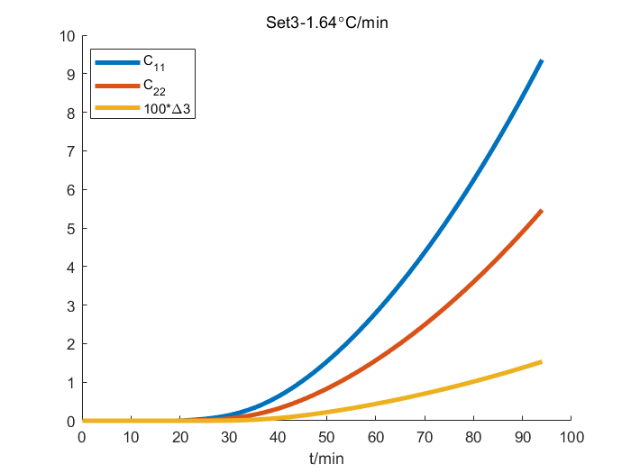


4.1 Optimal Experimental Design
Already know
$\frac{d logN(t)}{dβ_{i}}= \frac{d logN(t)}{dt}$· $\frac{d t}{dβ_{i}}$
=$\frac{d t}{dT(t)} ·$ $\frac{dT(t)}{dK_{max}}$ · $\frac{dK_{max}}{dβ_{i}}$
The longer the Exp runs, the more accurate the parameter estimation will be.

Slide 20
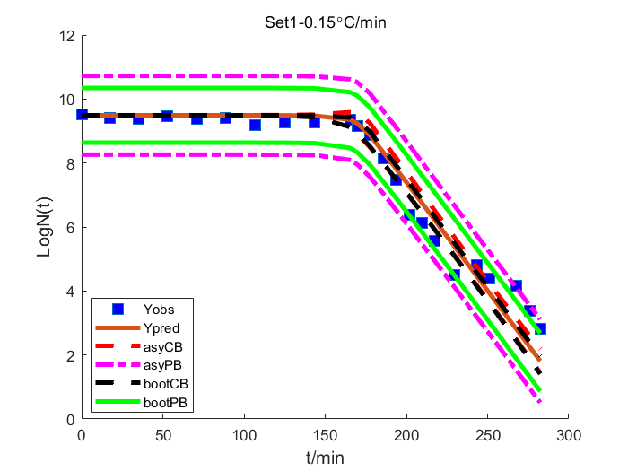
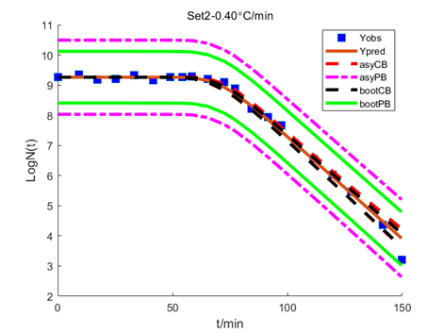
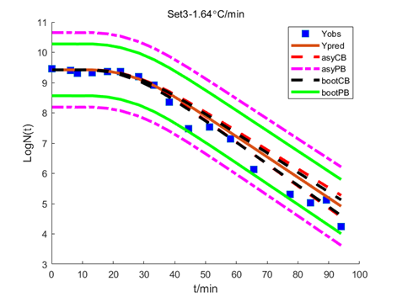
4.2 Bootstrapping
Asymmetric, smaller bands and closer to the truth

Slide 21
5
Summary

Slide 22
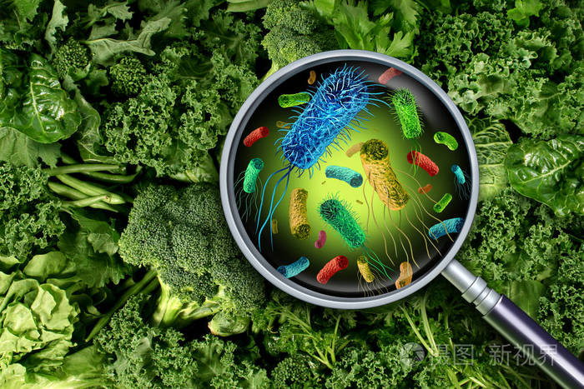
 | Parameters | Result | Stderr | Relerr(%) | 95% Ci
1 | AsymD | 6.3519 | 1.9537 | 0.3076 | 3.0521 | 10.3990
2 | z | 3.5544 | 1.2000 | 0.3379 | 1.3986 | 6.2223
The parameter estimation is completed by initial guess, INV and bootstrapping.
May help design a microbiologically safe process, to avoid fail dangerous or overly conservative heat process in food processing.

Slide 23
Thank You for Your Attention

